Slide 1
6 Seasons of Bangladesh
Md. Ashik Karim Nayon 0272310005101063

Slide 2
Contents
Summer (Grishsho)
Monsoon (Barsha)
Autumn (Shorot)
Late Autumn (Hemonto)
Winter (Sheet)
Spring (Boshonto)

Slide 3
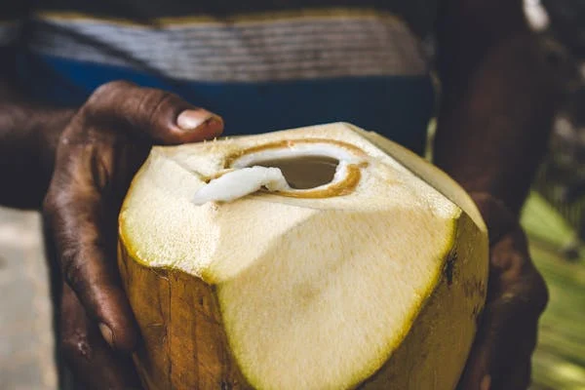
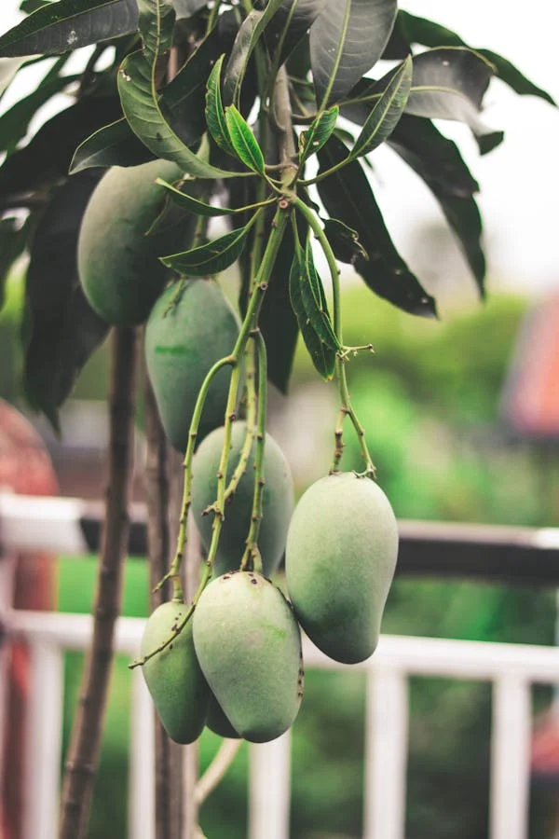
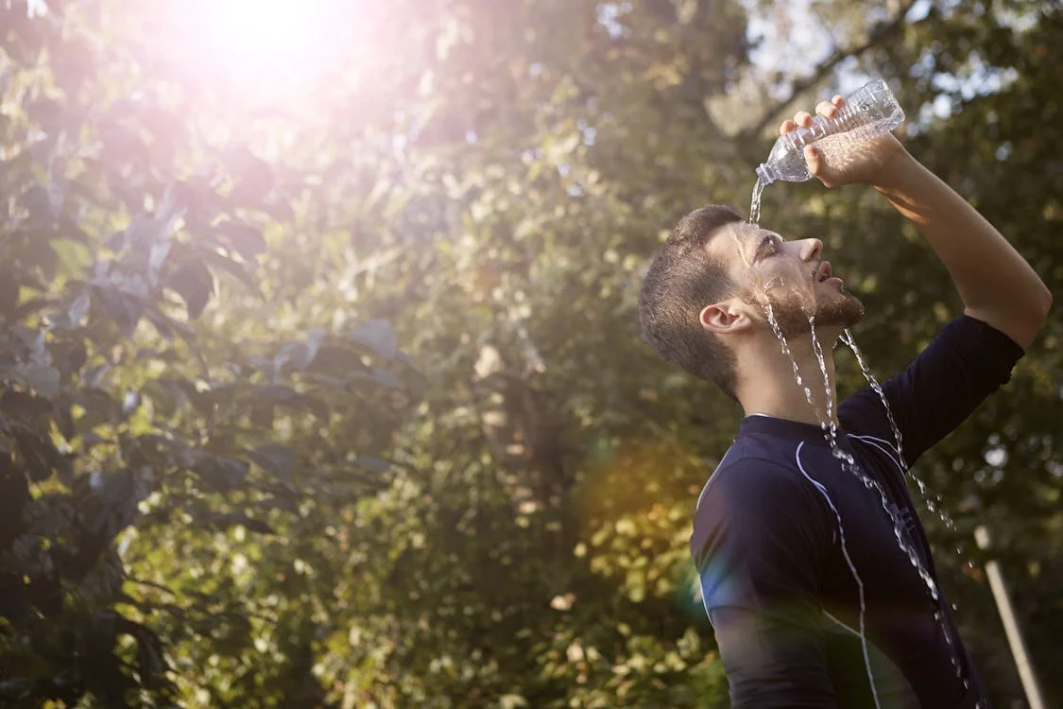
Summer
The first season in bengali calender is the summer.'BAISHAKH' and 'JAISTHA' consists summer. During summer the sun shines hotly. Summer is also the season of various fruits,various seasonal fruits ripe then.

Slide 4
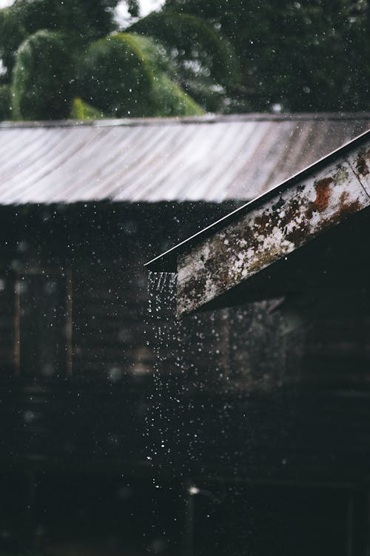
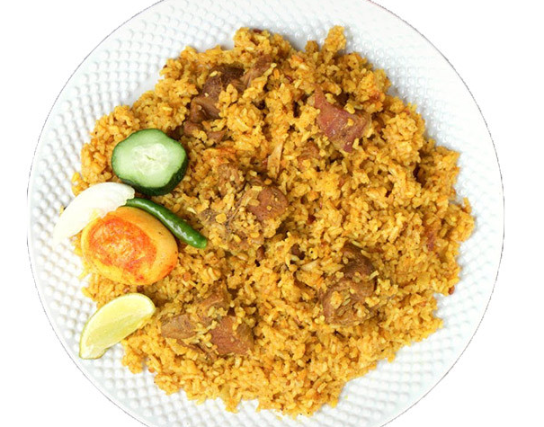
Monsoon
After summer comes the rainy-season.It's the second season. 'ASHAR' and 'SRAVAN' are the months of rains. It rains heavily now and then. Sometimes cats & dogs and sometimes in small drops. The main two crops of bangladesh rich and jute grow in this season.

Slide 5
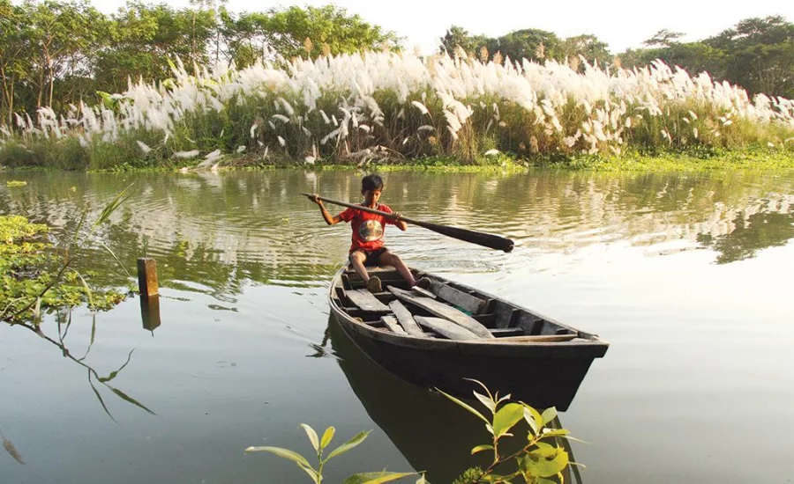
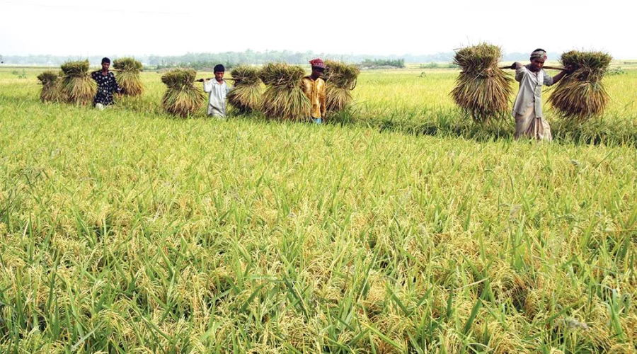
Autumn
After the rain comes the autumn. 'BHADRA' and 'ARSHIN' are the months of the season. Rain is not so copious. The sky looks deep blue and flowers bloom in this season.Days and nights are almost equal.

Slide 6
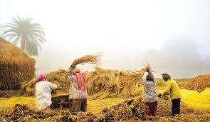
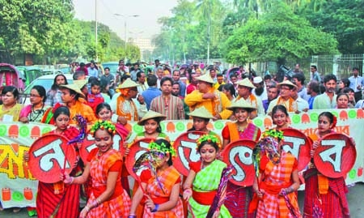
Late Autumn
The autumn falls into the late-autumn. 'KARTIC' and 'AGRAHAYAN' are the months of the late-autumn. It is a season of dew and farmers look happy.They are busy in harvesting perform the Nabanna.

Slide 7


Slide 8
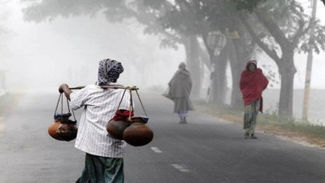
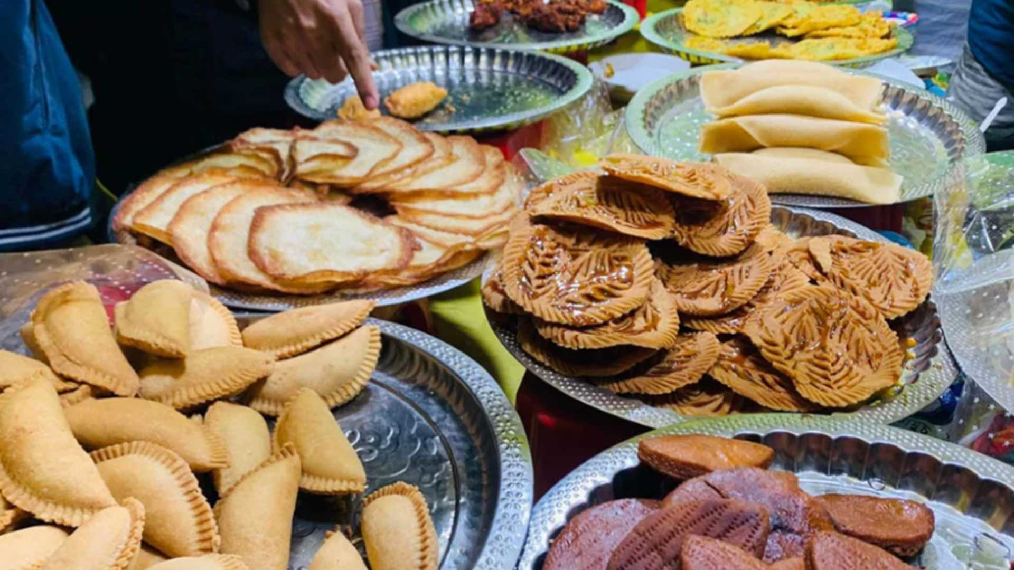
Winter
The late-autumn is following by the winter. 'POUSH' and 'MAGH' are the month of winter. Winter looks gloomy. It's days are shorter and nights are longer. Its season of fog.

Slide 9
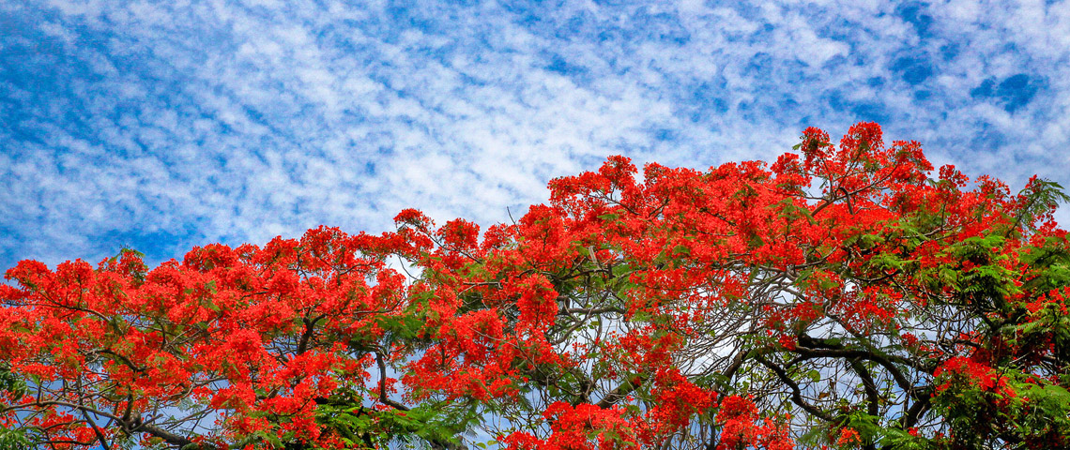
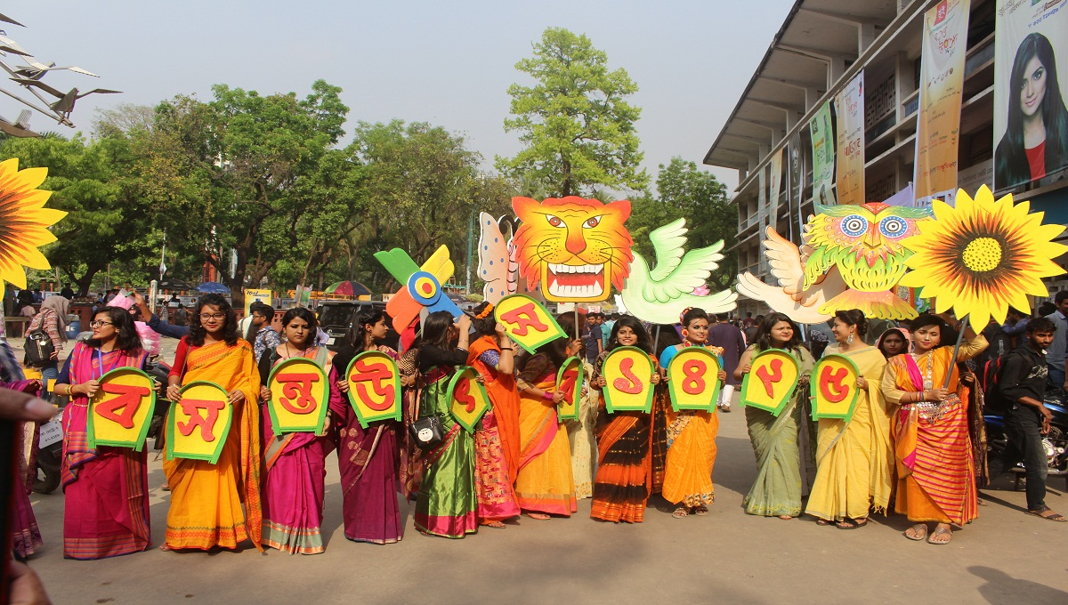
Spring
Spring is the best of all seasons. 'FALGOON' and 'CHAITRA' make this season. It's called the king. New leaves shoot out. Trees and plants look beautiful. The flowers bloom and give us sweetsent all around.

Slide 10

Any Questions?

Slide 11
Thank You.

